Slide 1

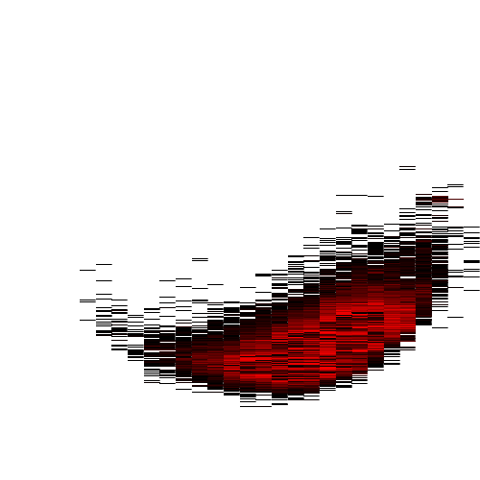
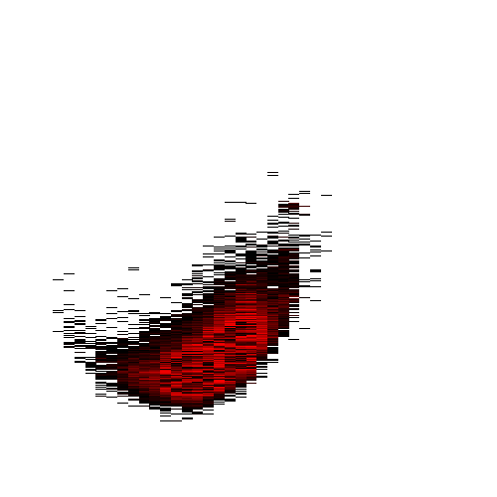
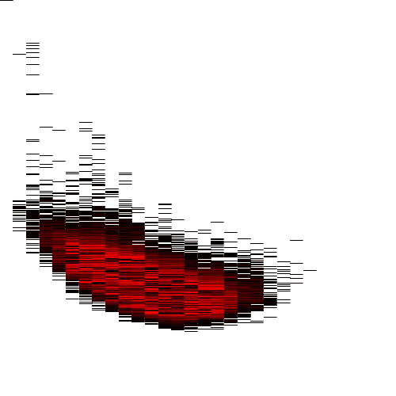
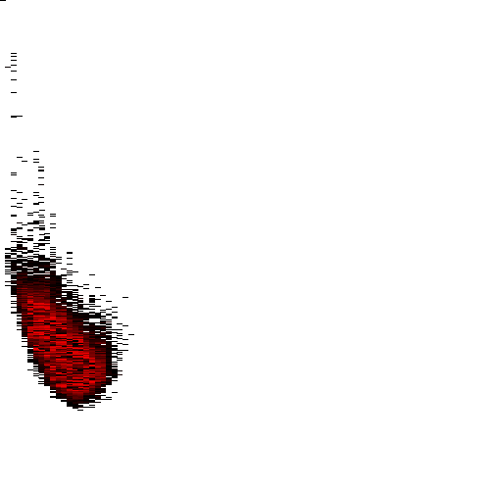






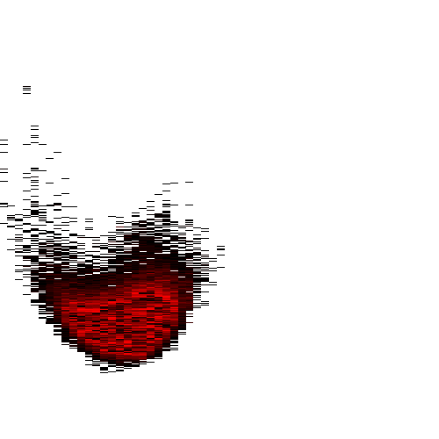
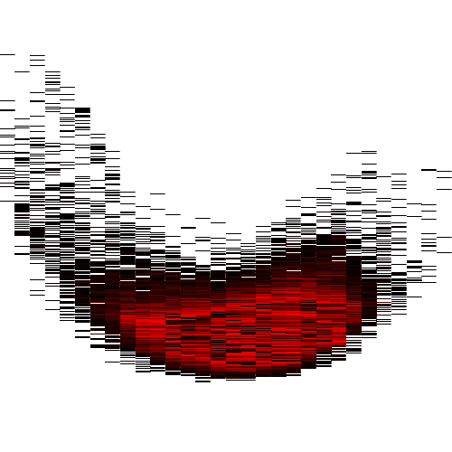
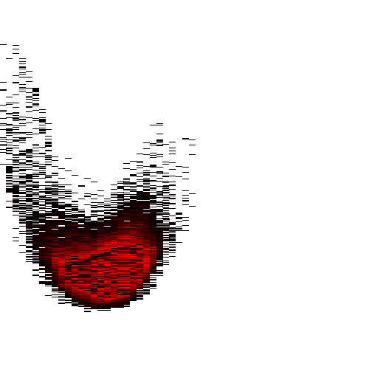
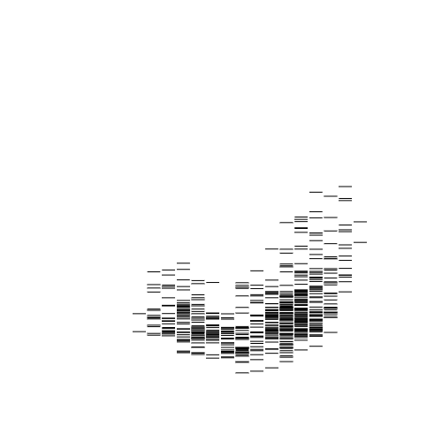


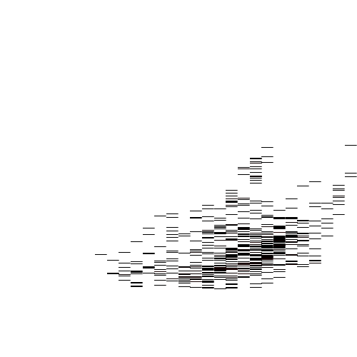
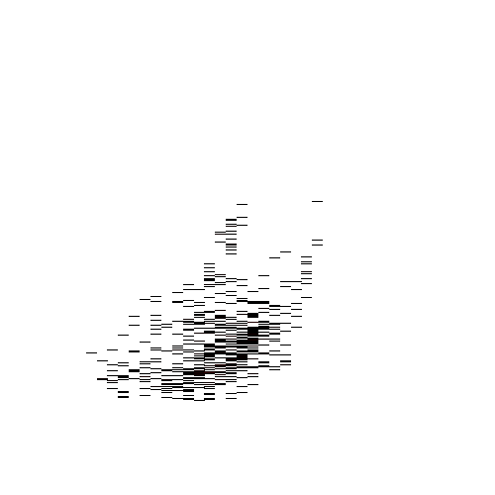
Standard
+ background
Standard
+ background
Standard
NC_000002.12 GPC1 glypican 1
PPP1R3A – protein phosphatase 1 regulatory subunit 3A
NC_012920.1 Homo sapiens mitochondrion, complete genome
(c)
(d)
GPC1 gene
PPP1R3A gene
+ background
NC_012920.1 Homo sapiens mitochondrion, complete genome
GPC1 promoter
PPP1R3A promoter
(b)
CRHR2 – corticotropin releasing hormone receptor 2
LMNA – lamin A/C
(e)
(f)
tilt
CRHR2 gene
LMNA gene
(a)
perpendicular
CRHR2 promoter
LMNA promoter
Regresion line

Slide 2


Examples of ODSs
Examples of ODSs. (a) shows an approach to the ODS analysis using a regression line and a line perpendicular to the regression line which indicates the angle to the vertical position. (b) shows both the standard ODS (above) and the optional ODS (relative to the global CG% content) for the mitochondrial genome of Homo sapiens. (c-f) Each of the four panels shows the ODSs of four genes and the ODSs of their promoters (DNA sequences from position -499b to 100b, relative to the transcription start site - TSS). In each panel the left side shows the standard ODS of the gene (top) and the standard ODS of the promoter of the respective gene (bottom). Optional ODSs that are relative to the overall CG% content are shown on the right side of each panel for the same genes and promoters. Note that the information content is shown in descending orientation from top to bottom on the vertical axis of each ODS and the ascending frequency is shown from left to right on the horizontal axis.
Cite this work as:
Paul A. Gagniuc. Algorithms in Bioinformatics: Theory and Implementation. John Wiley & Sons, Hoboken, NJ, USA, 2021, ISBN: 9781119697961.

